Slide 1
AUTOBIN
Hallothon 2021
Team
Srinivasa Raghavan S
Jaaswin D Kotian
Suhas R
Hemanth Hedge
Sanjivani Patra
Shubha

Slide 2
Problem Statement
Need for efficient waste management using
waste segregation

Slide 3
Solution
Computer vision based waste classification in a single Dustbin.
AutoBin

Slide 4
Software
1.Deep Learning Model
Waste image classification using RestNet50 with 94% accuracy. The model is trained on TrashNet dataset
RestNet50- A convolutional neural network that is 50 layers deep. Pretrained from ImageNet dataset.

Slide 5
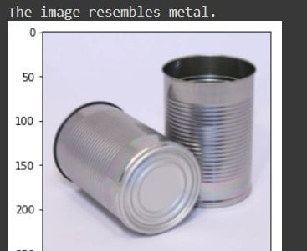
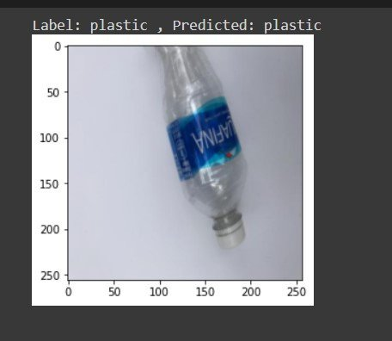
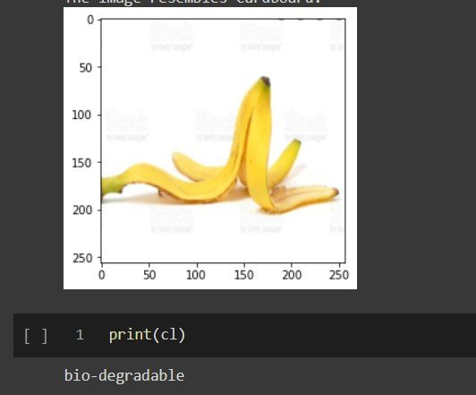
Model Results

Slide 6
2) Prototype using Solidedge
Solid Edge is a 3D CAD, parametric feature and synchronous technology solid modeling software.
A 3D prototype of the AutoBin is made using solid edge

Slide 7
Solid Edge Autobin demo

Slide 8
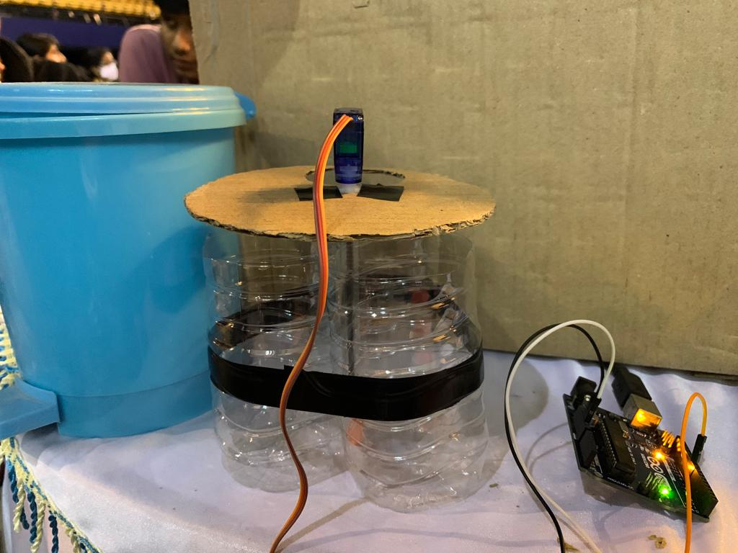
Hardware
A protoptype has been developed using arduino/Raspberry Pi .
Rotating servo motor has been used to place the garbage on the specified classification slot.
Moisture sensor is used for wet waste detection.

Slide 9
Hardware Demo

Slide 10
Target Audience
Organizations and Societies who want efficient, eco-friendly and convenient solutions.

Slide 11
Start small before going all out.
Currently AutoBin is focused on small-scale sequential garbage input.
Our Future vision is to expand to households by building AutoBin waste segregation plants in every society to segregate bulk waste.

Slide 12
Project Links
https://colab.research.google.com/drive/1t668MHsyhj-SGvFRzQzQ2qDNP1ujLiM9?usp=sharing

